Slide 1
CUSTOMER CHURN PREDICTION
PRESENTED BY,
PARVATHY VYSAKH
PATRICIA ADOLPH
POOJA SELBY
SUCHITHRA CHANDRASEKHARAN

Slide 2
CONTENTS
INTRODUCTION
EXPLORATORY DATA ANALYSIS
DATA PREPROCESSING
MODELLING
CONCLUSION

Slide 3
introduction
Customer churn is the loss of clients or customers.
The dataset is a telecom customer dataset. The objective of this project is to predict whether a customer will leave a particular telecom company or not.
Companies usually make a distinction between voluntary churn and involuntary churn.

Slide 4
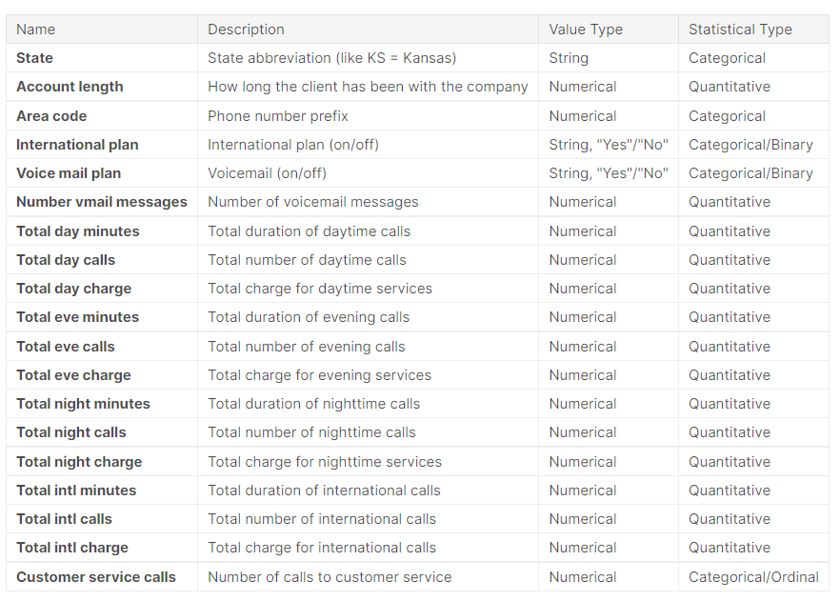
DATA DESCRIPTION

Slide 5
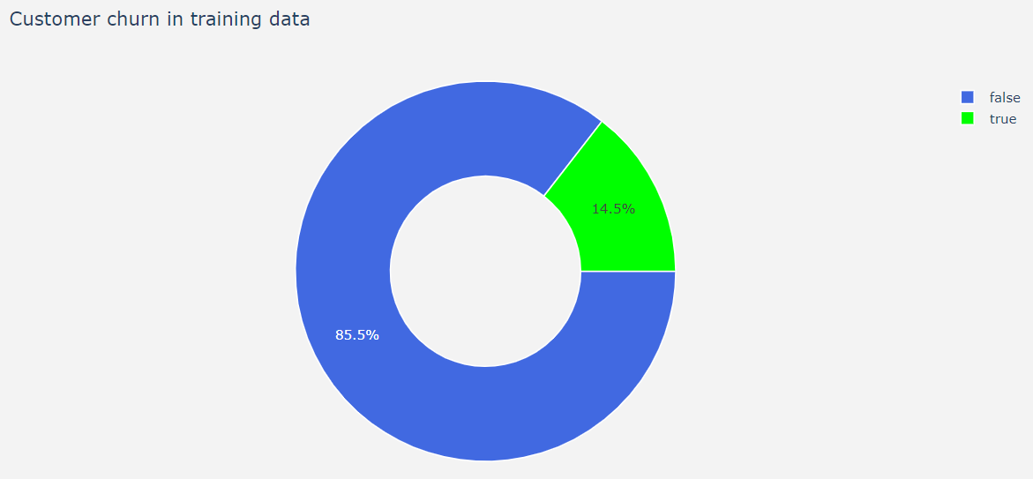
Exploratory data analysis
Fig 1.1 Pie Chart representation of target feature churn

Slide 6
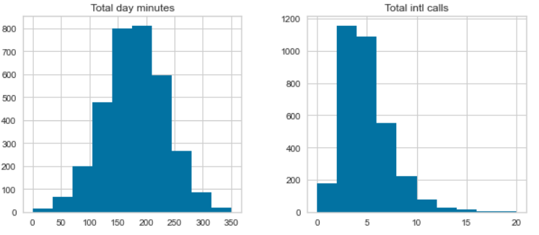
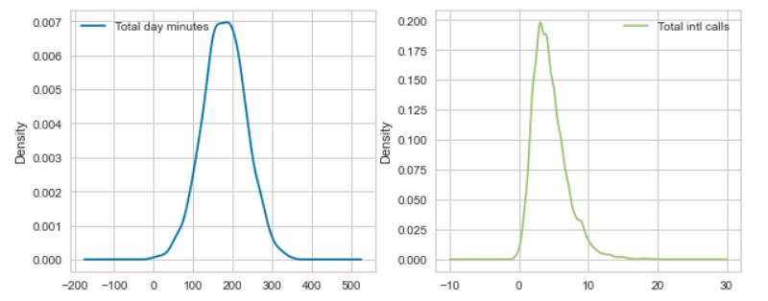
Exploratory data analysis…
Fig 1.2 Distribution of Total day minutes and Total intl calls using histograms
Fig 1.3 Distribution of Total day minutes and Total intl calls using densityplot

Slide 7
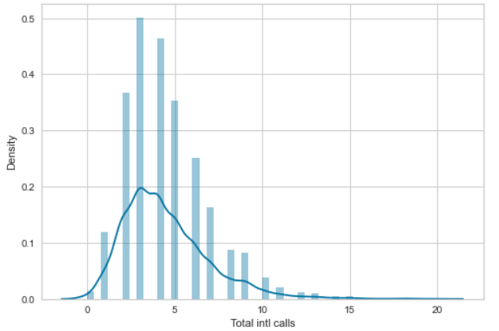
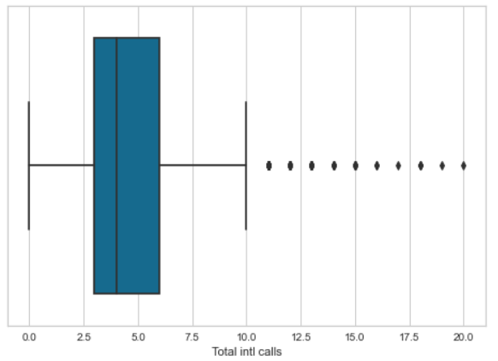
Exploratory data analysis…
Fig 1.4 Distribution of Total day minutes and Total intl calls using distplot
Fig 1.5 Distribution of Total day minutes and Total intl calls using boxplot

Slide 8
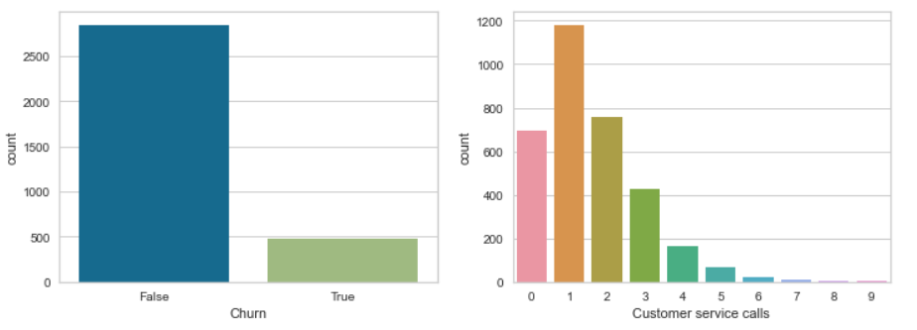
Exploratory data analysis…
Fig 1.6 Barplot for the distribution of categorical variables churn and customer service calls

Slide 9
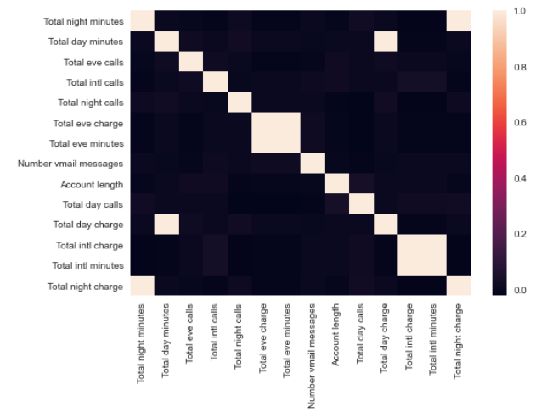
Exploratory data analysis…
Fig 1.7 Multivariate analysis using Correlation matrix

Slide 10
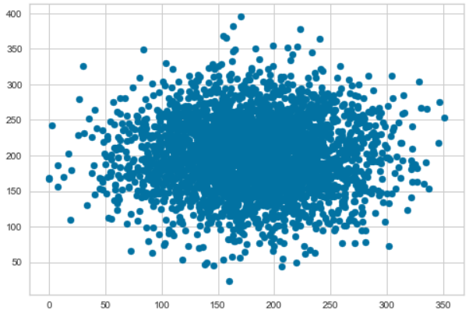
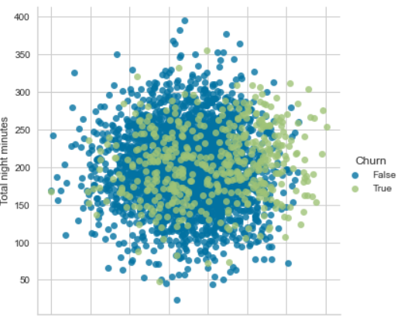
Exploratory data analysis…
Fig 1.8 Multivariate analysis using Scatterplot
Fig 1.9 Multivariate analysis using lmplot()

Slide 11
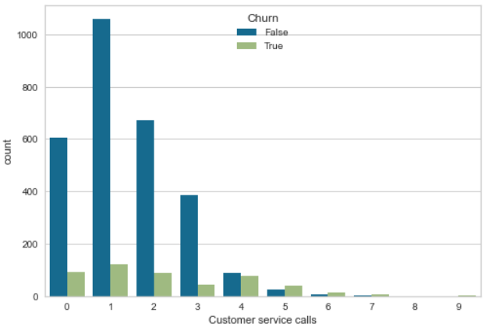
Exploratory data analysis…
Fig 1.10 Multivariate analysis customer service calls and churn using countplot

Slide 12
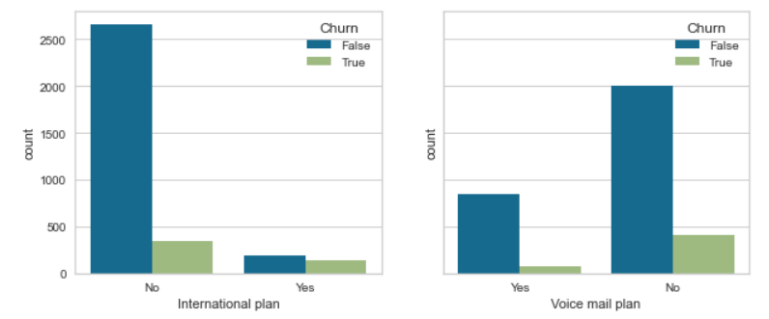
Exploratory data analysis…
Fig 1.11 Multivariate analysis of Churn and the binary features, International plan and Voice mail plan using countplot

Slide 13
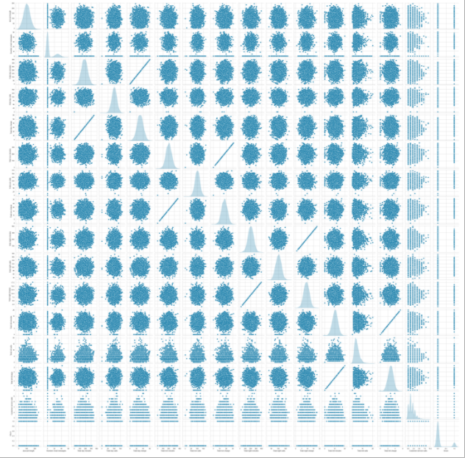
Exploratory data analysis…
Fig 1.12 Bivariate distributions using pairplot

Slide 14
Data pre-processing
Based on the conducted exploratory data analysis we have discarded some of the features as they are highly correlated.
Separated the categorical and numerical variables
Performed label encoding in binary features
Scaled the numerical features
Prepared the dataset for modelling by splitting them as train and test.

Slide 15
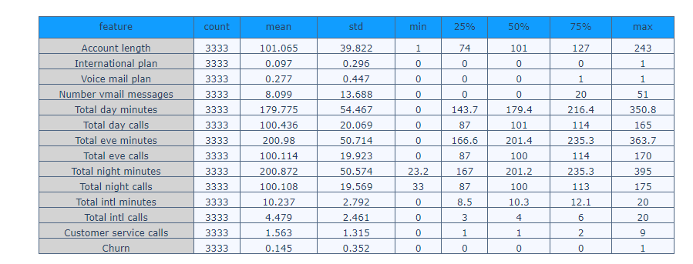
DATA pre-processing …
Fig 1.13 Training variable Summary

Slide 16
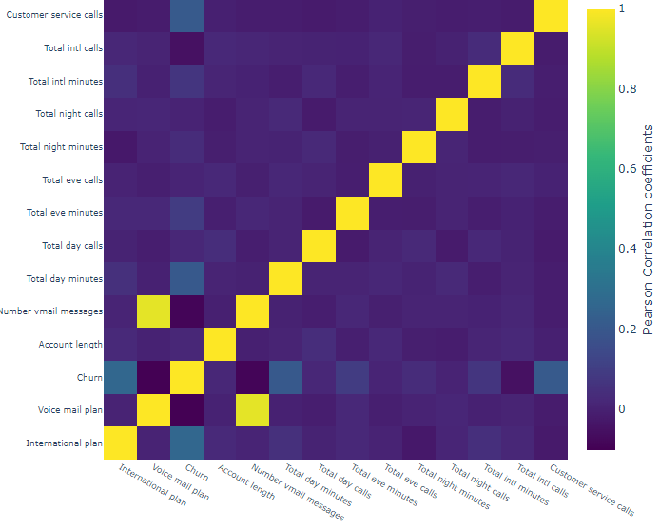
DATA pre-processing …
Fig 1.14 Heat map or correlation Matrix

Slide 17
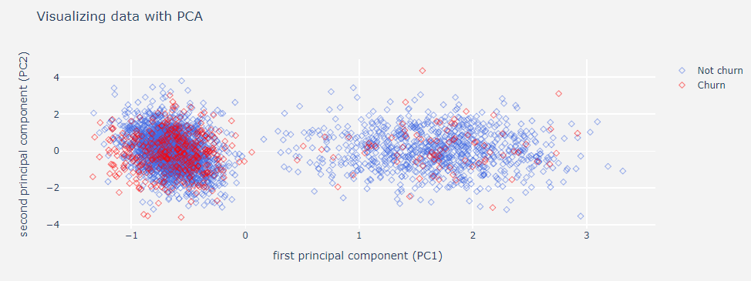
Data pre-processing..
Fig 1.15 Visualizing data with PCA

Slide 18
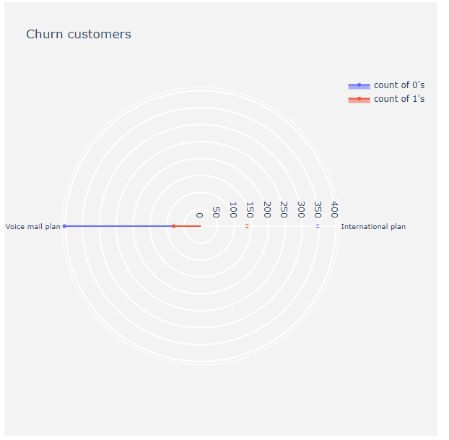
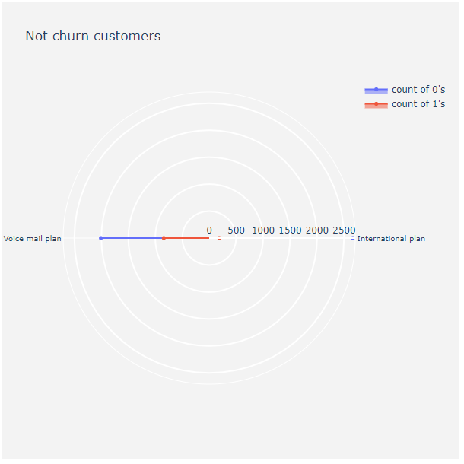
Data pre-processing..
Fig 1.16 Radar plot for churn and non churn customers

Slide 19
Modelling
We have used Random Forest Classifier.
Random forests or random decision forests are an ensemble learning method for classification, regression and other tasks that operates by constructing a multitude of decision trees at training time.

Slide 20
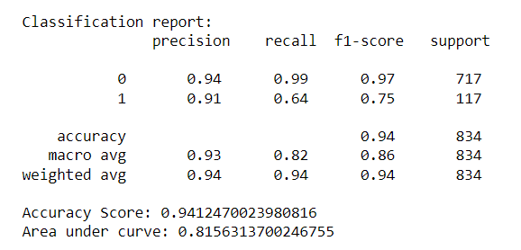
Modelling…
Fig 1.17 Classification Report

Slide 21
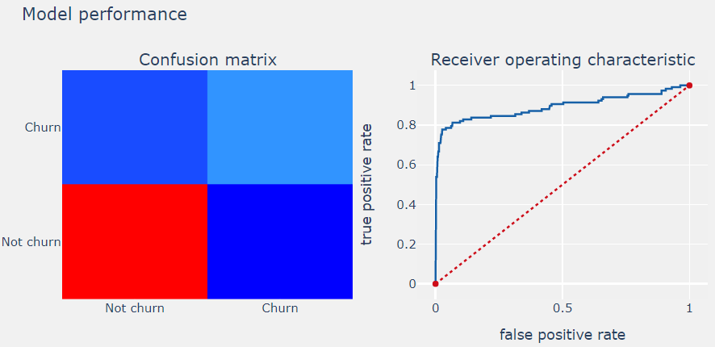
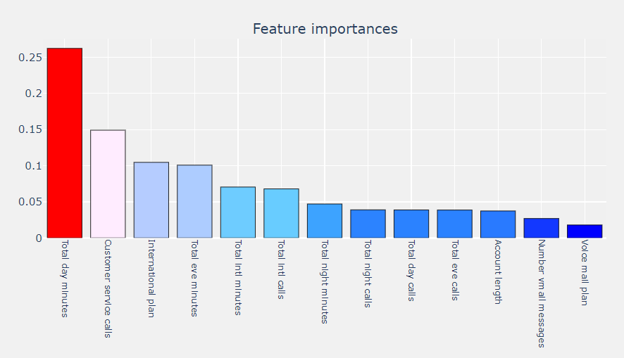
modelling…
Fig 1.18 Confusion Matrix and Area under Curve
Fig 1.19 Feature Importance

Slide 22
CONCLUSION
Accuracy of our model is: 94%.
The AUC, we have got from our model is 0.81 which is high indicating the better performance of our model.

Slide 23
THANK YOU….

